Slide 1
Neurophysiology with anesthetized earthworms
Ben Latimer – Computational Neurobiology Center – University of Missouri

Slide 2
Experiment 1: Introduction to Conduction Velocity
In this activity, you will use an anesthetized earthworm and the two channel Spikerbox from Backyard Brains to measure conduction velocity.

Slide 3
What you need
Box of earthworms (Preferably large nightcrawlers used for fishing, available at Wal-Mart or fishing supply store)
Two-channel Backyard Brains Spikerbox
Alcohol (isopropyl or high proof liquor like everclear)
Computer with Audacity installed (Free from http://www.audacityteam.org/)

Slide 4
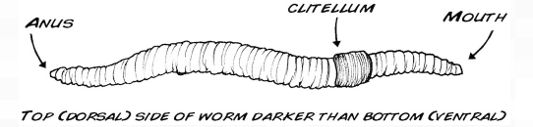
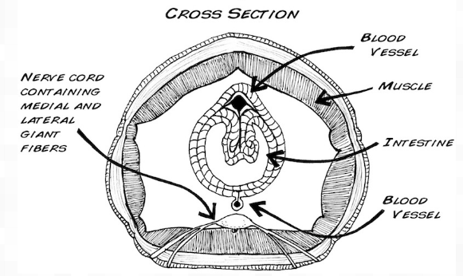
Earthworm Anatomy

Slide 5
Procedure
Anesthetize the earthworm by preparing a 10% alcohol in water solution. Place the earthworm in the alcohol solution for 5-10 minutes, until it has stopped moving.
Lay the earthworm on a piece of Styrofoam or cardboard and place the electrodes as shown on the following slide.
Press the “record” button in Audacity and touch the earthworm at the end nearest Electrode 1.

Slide 6
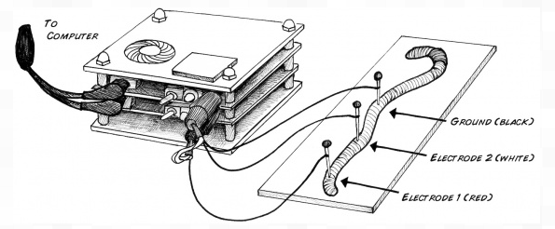
Procedure

Slide 7
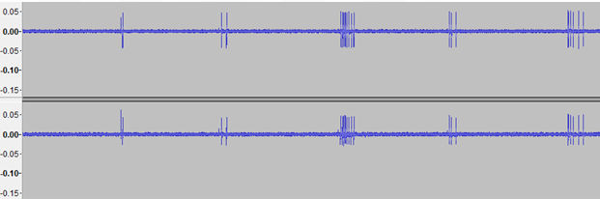
Procedure
You will see action potentials like the ones below.

Slide 8
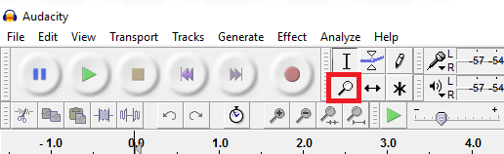
Procedure
If you click the magnifying glass icon, you can zoom in on the signal

Slide 9
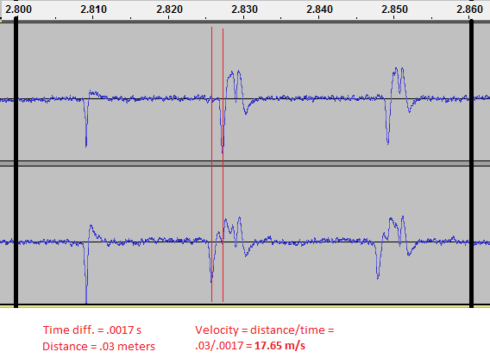
Results
Once zoomed in, you can see there is a slight delay between the first channel (top) and the second (bottom).
Measure that time delay (using the scale provided on the top) and divide the distance between the two electrodes by the time difference. The result is the speed the action potential is traveling down the worm.

Slide 10

Experiment 2: Effect of Nerve Stretch on Conduction Velocity
Backyard Brains has an excellent video on extending the conduction velocity experiment.
https://youtu.be/uNM06ONoBAY

